Slide 1
Hospital Management System
Using the latest version of application, the developers have created a framework that can be easily modified and reused.

Slide 2
Challenge
One of our client wanted to develop a Hospital Management application for hospital staff. He wanted to automate all daily activities in the clinic and thus provide quality services to patients.
Meeting specified security, technology and functionality standards for managing electronic medical records and complete Patient Information was the main objective of developing this application.
Objective
To develop a system which can help managing Doctor's appointments, medical billing, patients' treatment history, diagnostics information and the administrative activities of a clinic or a hospital

Slide 3
Solution
Clearpath Network Infotech came up with a solution (Hospital Management) that was extremely useful and efficient with following features:
Appointment Scheduling
Front Office Management
Client Profile Management
Inventory Management
Procurement Process
OPD Process
Pathology Process
MIS Reports
CMS

Slide 4
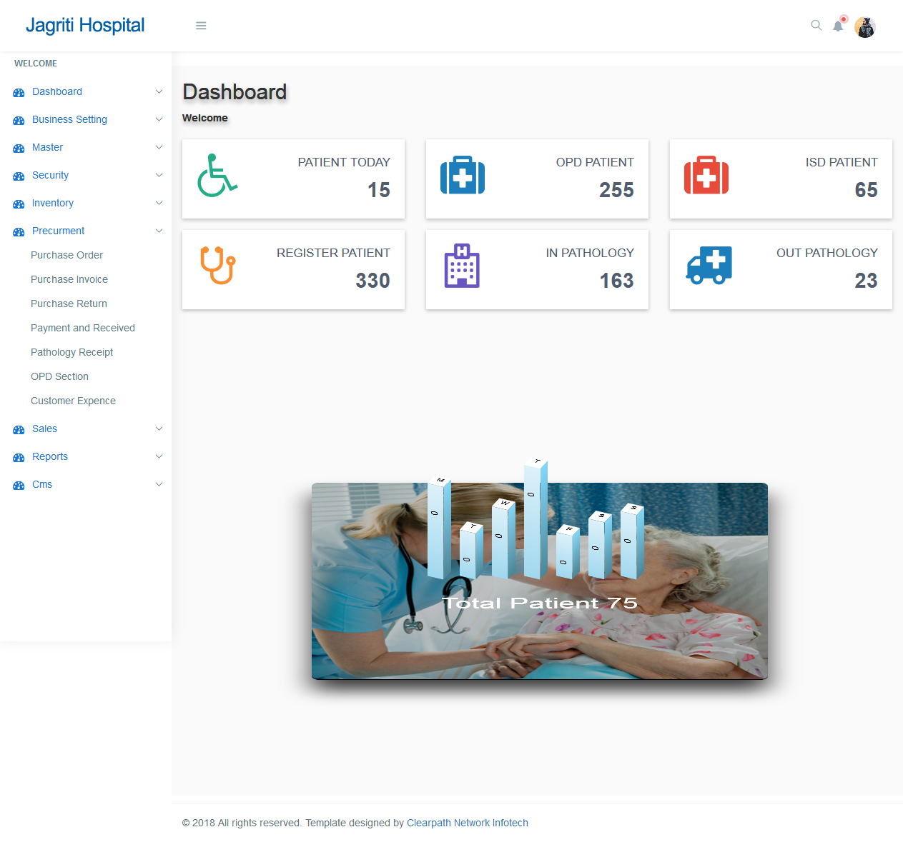

Slide 5
Appointment Scheduling
Internal E-mails
Scheduling Appointments which includes:
Daily appointments management
Assigning counselor
Billing schedule Maintenance

Slide 6
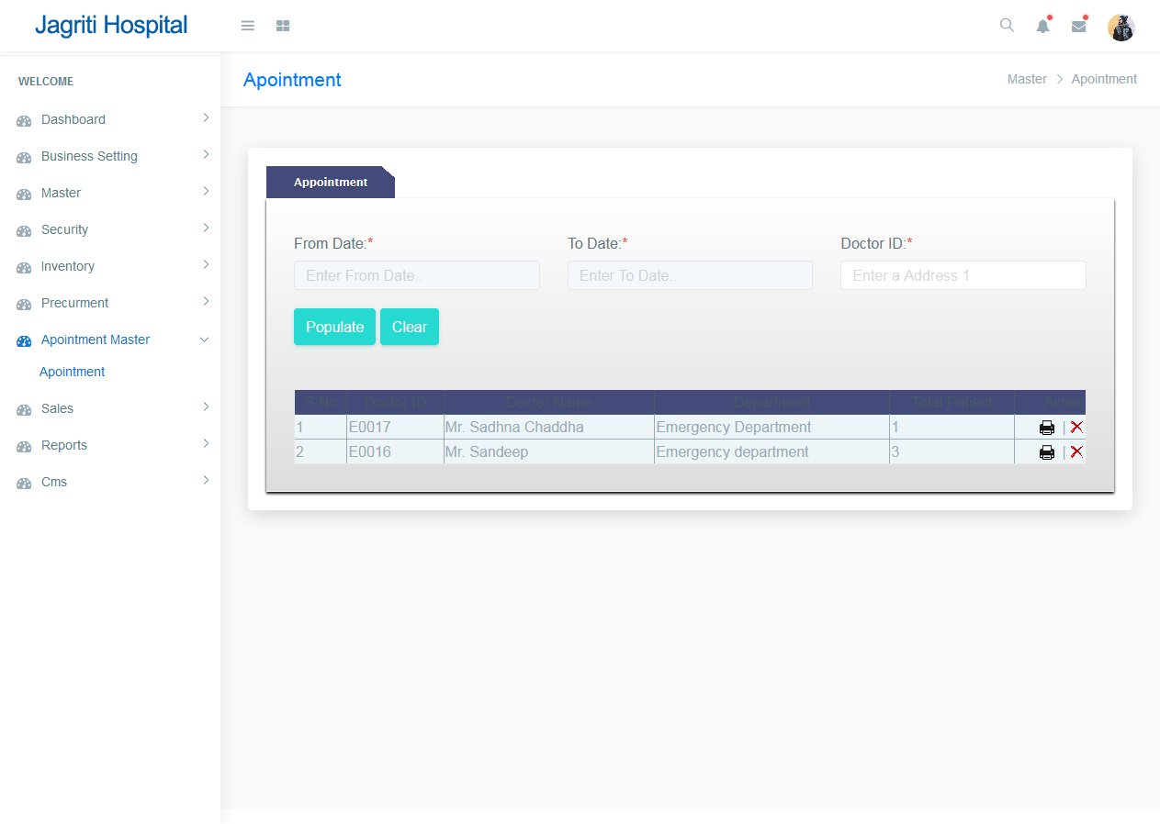

Slide 7
Front Office Management
Check-in, check-out and hold the patients
View and search patient details
Managing patients' payment details
Medical claim patient Management

Slide 8
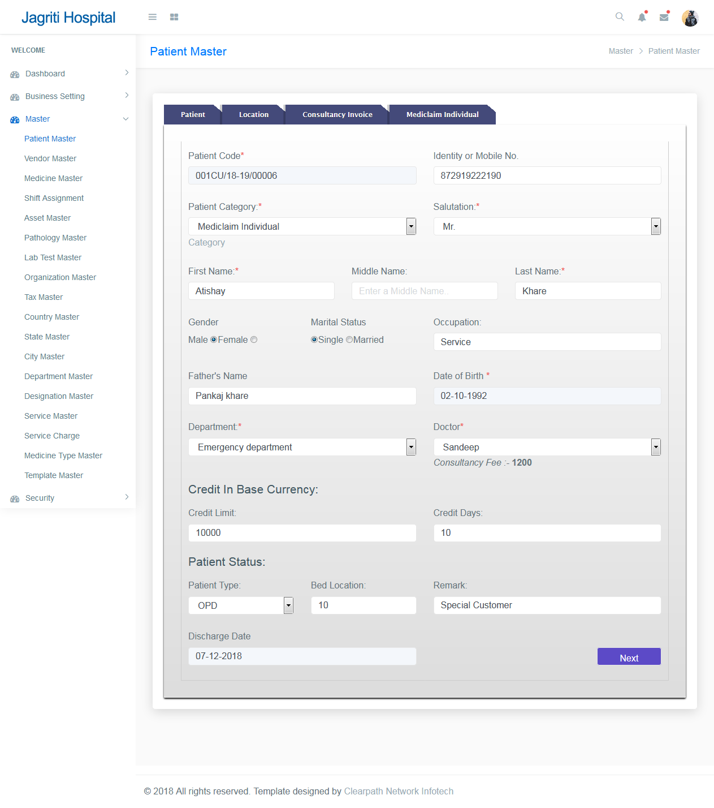

Slide 9
Client Profile Management
Patient demographic and contact information
Patient-Doctor assignment
Maintaining Blood Group, Height, Weight, ESIC, Voters Card No. etc.
Admission and discharge information
Billing information

Slide 10
Inventory Management
Sale / Purchase data entry
Sale / Purchase return
Medicine Sale
Medicine return
Stock Adjustment
Clinical items management such as drugs, pumps etc.

Slide 11
Pathology Process
Pathology master to create Pathology In details
Add Lab Test
Assign Pathology and Test to Patient
Generate Pathology Receipt for Patient

Slide 12
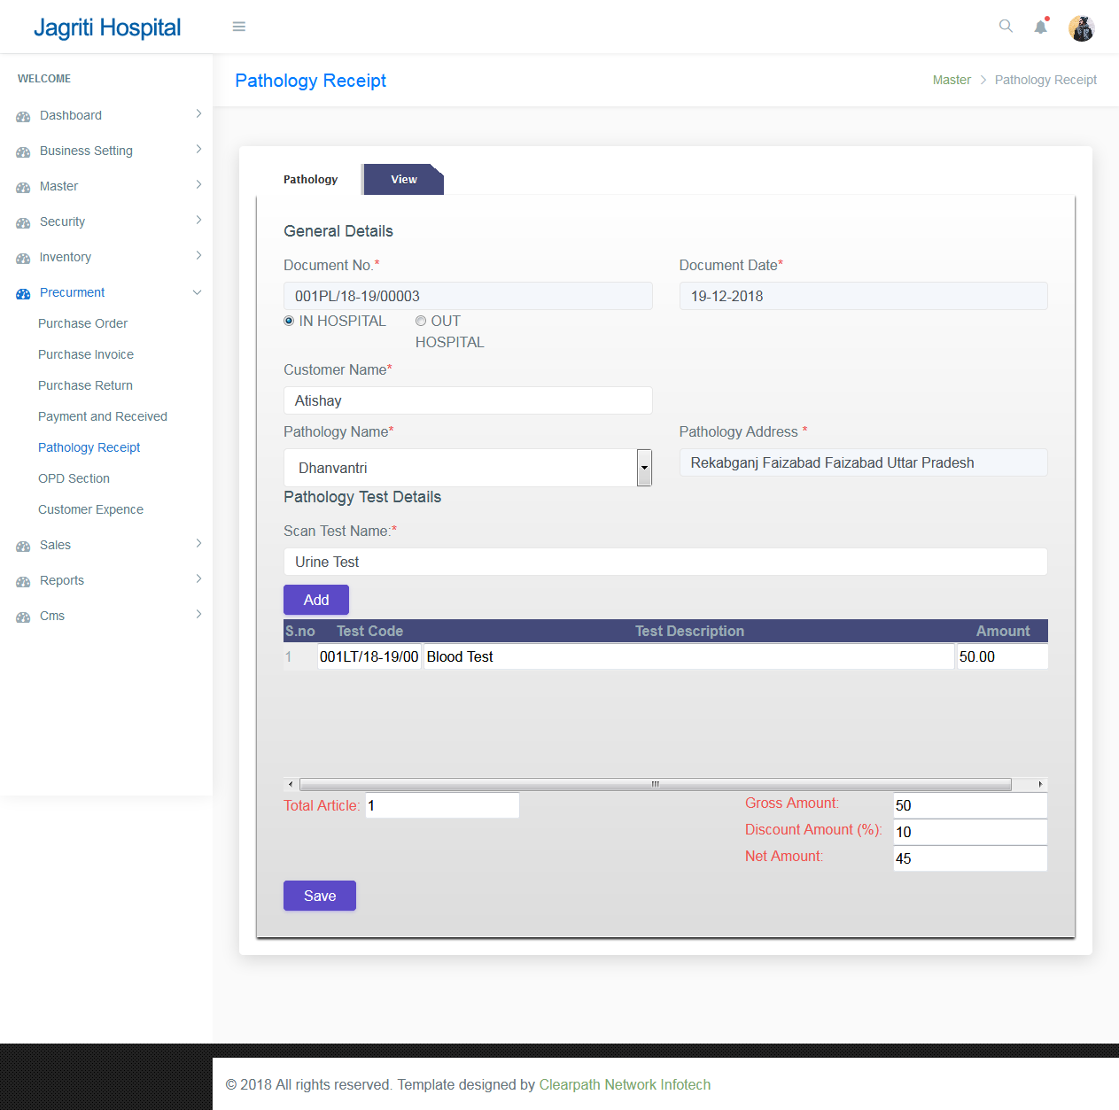

Slide 13
Reports
Appointment Details
Payment History's
Credit Memo & Cash Memo
Sale Register Patient Wise
Inventory Status as on date
Discharge Report
Receipt and Payment Details
Tax Invoice
GST Sale & Purchase Summary
Patient Wise Sale & Purchase Details

Slide 14
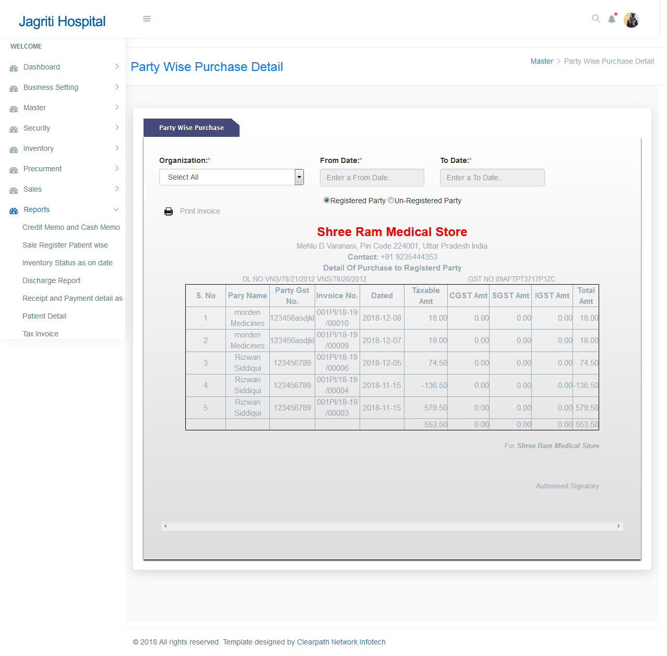

Slide 15
Result
Apart from the standard features of other clinic management software, our Hospital Management System resulted in easing daily activities of doctors and clinic staff
Features such as ease of use, speed of information retrieval, multi-user functionality and manageability are exemplary compared to other applications
Professional solution for doctors which resulted in increased reputation and revenue of their clinics

Slide 16
Technology
Server : Microsoft Windows Server
Web Server : WAMP Server
Programming Language : Php, javascript, jquery, Ajax, json, Bootstrap, Html
Database : MY SQL

